Slide 1
October 29th Referendum
Clerk/Treasurer Position Informational Meeting

Slide 2
Clerk/Treasurer Position History
The City of Kaukauna has had an elected Clerk/Treasurer position since 1988.
It is now one of the last municipalities of this size in the State to have this position elected.
Other communities have moved to an appointed split position because of the ever-changing requirements and responsibility of the role.
Clerk and Treasurer duties are more administrative duties within the City rather than a policy maker.

Slide 3
Adhoc Special Committee
Committee met on four occasions.
Deliberated on the current structure and how it was working.
Interviewed current staff members on the organizational structure as it is today.
Interviewed: Manitowoc, Menasha and Neenah.
None of these surrounding like communities had an elected, combined position.
All had a position description more than the State Statute provides.
***Committee Members included: Mayor Penterman (Chair), Will Van Rossum (Finance Director), Denise Vanderloop (Human Resources Director), Mike Coenen (Council President), Phil Kohne (Alderman Representative), Mike Weaver (Citizen Rep), Steve Haen (Citizen Rep), Ron Van De Hey (Citizen Rep), Pat Landreman (Citizen Rep). ***

Slide 4
Treasurer Duties
Handling Cash/Bank Deposits
Properly Invest City’s Reserve Funds
Proper Tax Collection ($18 million annually)
6,655 tax bills are sent out annually.
Cash Management
Financial Reporting
State and County Reporting

Slide 5
Wisconsin Department of Revenue (DOR) Calendar of Events
May
Municipal Financial Report filed with DOR.
July
Tax Increment District annual reporting.
August
Equalized value review.
October
Deadline to request charge back of refunded or rescinded taxes – PC201.
December
Levy limit worksheet.
January
January settlement filed with taxing jurisdiction.
Treasurer deadline to apply for lottery and gaming & 1st dollar credits to tax bill.
First property tax installment due.
February
February settlement with taxing jurisdictions.
April
Tax charge back report filing.
Expenditure Restraint Program worksheet.
https://www.revenue.wi.gov/DORReports/tvccal.pdf

Slide 6
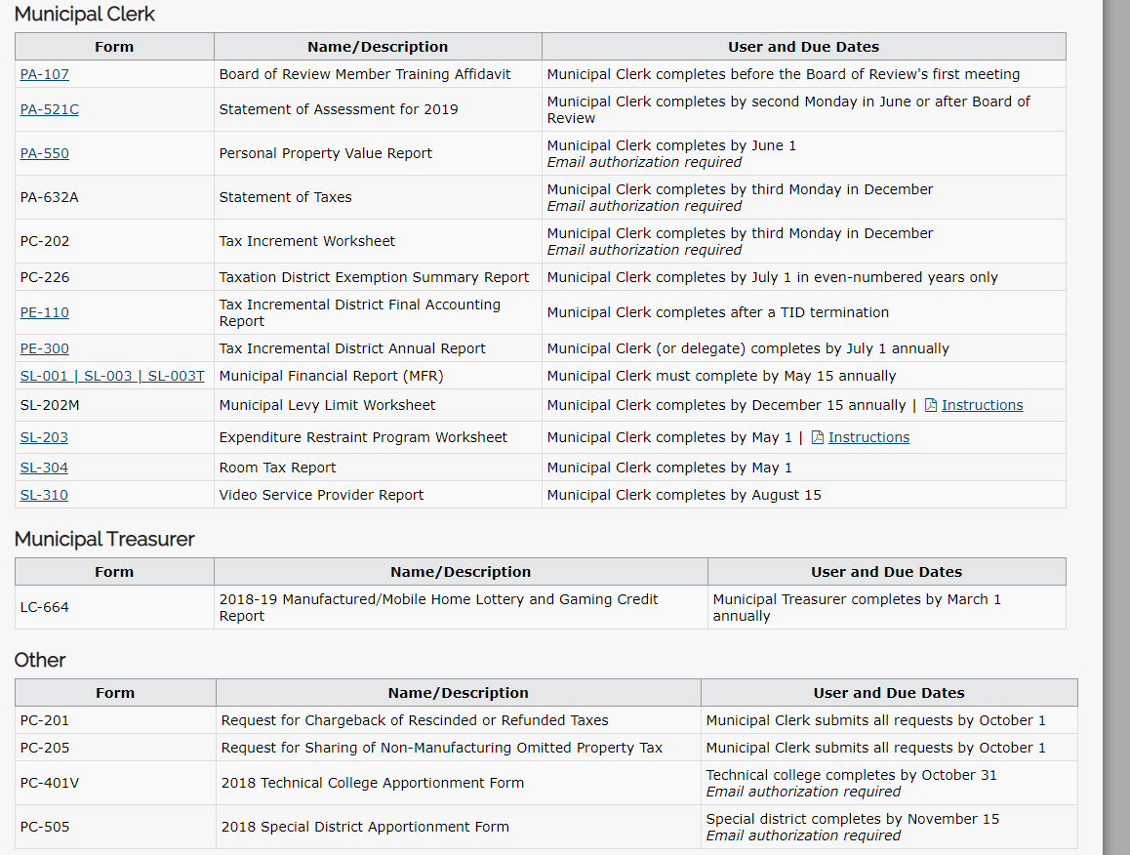
DOR Forms Examples
https://www.revenue.wi.gov/Pages/OnlineServices/slfiling.aspx

Slide 7
Levy Limit Form
What is the Levy Limit Form
Form that reports max Levy amount that can be taxed for year.
City is penalized in following year if levy is over limit.
Critical part of the budgeting process.

Slide 8
Tax Collection Filing
Clerk’s office handles roughly $18 million dollars around tax season.
Daily reporting into the County system.
Report total collected at Deadline(Dec 31 and Jan 31).
Accounting for the different taxes collected.
Real Estate
Personal Property
Special Charges
Report out what was collected and send payments to other taxing jurisdictions (KASD, FVTC, County).
Responsible for being accurate or risk shorting the City.

Slide 9
Clerk Duties
Care and custody of municipal papers and records and transfer of those records to the Clerk’s successor.
Attend Common Council board meetings and keeping a full record of the proceedings.
Allowing inspection of records permitted by Wisconsin’s open record laws.
Maintaining: Minutes, Ordinances, Resolutions, Licenses & Permits.
Issuing & Maintaining Licenses (Dog, Bartender, Liquor, etc.).
Knowing and understanding the City Ordinances and Resolutions.
Coordinate and reconcile elections along with posting notices.

Slide 10
Ordinance and Resolutions
What’s an Ordinance?
A piece of legislation enacted by a municipal authority.
Local laws passed by municipal government (Council) that governs the City.
What is a Resolution?
A firm decision to do or not to do something
The official expression of the opinion or will of a legislative body.
Why are both records important?
Both serve a purpose in controlling and directing the City in a direction that is believed to be best for the community as a whole.
**Binders displayed for examples of past documents**

Slide 11
Elections
Responsibilities
Publications around elections.
Absentee ballots.
Hiring poll workers.
Election inspector report.
Declare and prepare polling locations.
Early voting.
Maintenance of the voting machines.
Submit polling results.
https://elections.wi.gov/sites/electionsuat.wi.gov/files/publication/65/2019_calendar_of_election_events_pdf_pdf_20220.pdf

Slide 12
Seize the Aligning STARS
The Three “C’s”
Continuity
Collaboration
Consistency
With the C’s, the STARS align
Stability
Team/Trust
Accountability
Reliability
Success

Slide 13
What is your reasons for voting for the Clerk/Treasurer?
Think back to April 3, 2018, when you came out to vote.
Did you checked the box because:
I know the name(s) on the ballot
Thought they were qualified to do all duties. (How do you know?)
The person is/was nice to me?
They know my friend, sister, mom, (insert anything here)

Slide 14
Did you feel informed before voting? (Again, think back to April 2018)
Did you consider the below points before voting for Clerk/Treasurer?
What does the Clerk/Treasurer position do?
Do they have experience to manage the City’s records and cash appropriately?
Do they have past experience with cash handling and management?
Will they run again next year to reinvest their experience into the City?
What effort goes into campaigning? If rerunning, is campaigning taking away from the responsibilities at the City?
If someone is rerunning, did they do a good job the previous term?
Before voting, how do you get to know the candidates to determine if they are qualified to do the job?

Slide 15
Why a Referendum?
The Special Committee, along with staff, feel the positon duties are too much for one person to do each one well.
The fast-paced environment of a Clerk/Treasurer makes it difficult to learn on the fly.
Many times Clerk duties fall parallel with Treasurer duties, making it difficult to give each duty the necessary attention.
Over the years, the WI Department of Revenue and Counties have increased reporting requirements for the position adding to the complexity.
Any turnover will burden the current staff on picking up anything missed or unknown
The performance of the person in the role can be evaluated on an ongoing basis

Slide 16
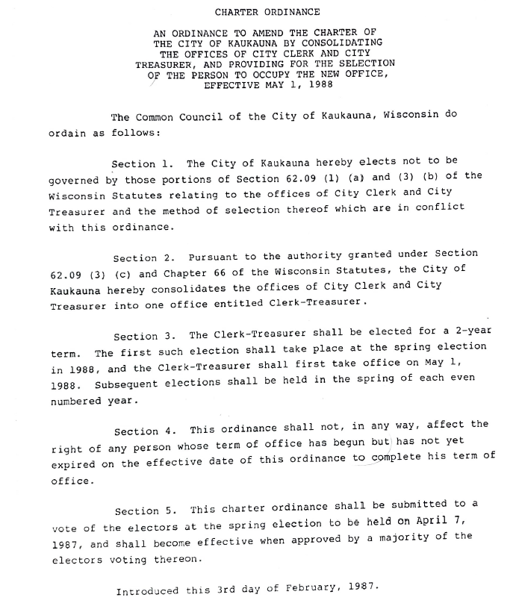
Why can’t the Council just change it?

Slide 17
What’s the Referendum Question?
Shall the City of Kaukauna, Outagamie County, Wisconsin change the Clerk/Treasurer position from elected to appointed?

Slide 18
What will a “No” vote do?
A “No” vote will keep the position as it is today, elected per the City Charter.
Points of Leaving Elected
Gives the voters the choice of who they want to fill the position.
Risk only having one choice (not including write-in).
Allows anyone without the necessary experience or education to run for position .
Would require the person filling the role to live within the City.

Slide 19
What will a “Yes” vote do?
It will make the position appointed, which will be hired rather than voted.
Points of Changing to Appointed
Making an appointed position would allow the candidates to be screened and interviewed to ensure they meet the criteria deemed necessary to perform at a high level in the position.
Being appointed will make the position accountable to the Mayor and Council who closely monitor the day-to-day activities.
Being appointed would provide stability in the position year to year and reduces the risk of turnover every two years in this critical role.
An appointed position would be considered an administrative role, aligning more with the duties.

Slide 20
Referendum Polling Location
October 29, 2019
Council Chambers
Municipal Service Building
144 W. Second Street
Kaukauna, WI 54130
Polls open 7 a.m.-8 p.m.

Slide 21
MyVote.wi.gov
Visit the above site to do the following:
Register to vote.
Update your name and address.
Your voting status and history.
Request an Absentee Ballot.
Find your polling location.
What is on my ballot?

Slide 22
Q&A Session on the Position
Please raise hand if you have a question and staff will answer one at a time.

